Slide 1

Digital Technology Infrastructure
Instructors:
Paola A. Gonzalez, Ph.D.

Slide 2
Questions to reflect
What are the major components of digital infrastructure?
How does digital (IT) infrastructure relate to business strategy?
How has cloud computing enabled digital transformation in organizations?

Slide 3
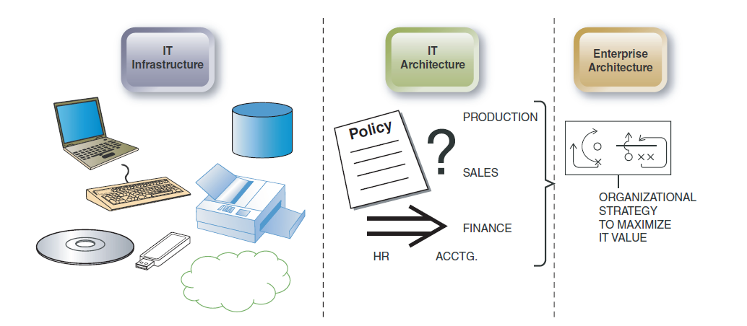
IT infrastructure, IT Architecture, EA

Slide 4
Major HW Components
Central processing unit (CPU): manipulates the data and controls the tasks performed by the other components
Primary storage: internal to the CPU; temporarily stores data and program instructions during processing
Secondary storage: external to the CPU; stores data and programs for future use
Input technologies: accept data and instructions and convert them to a form that the computer can understand
Output technologies: present data and information in a form people can understand
Communication technologies: provide for the flow of data from external computer networks (e.g., the Internet and intranets) to the CPU, and from the CPU to computer networks
Notes:
Hardware refers to the physical (tangible) equipment used for the input, processing, output, and storage activities of a computer system. It consists of:

Slide 5
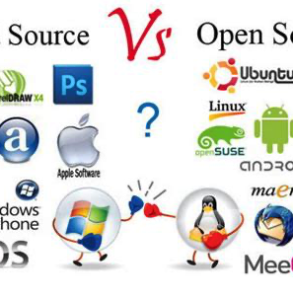
SW characteristics
What are the differences between systems SW and application SW?
What is open-source SW, and what are its advantages?
Notes:
Systems software is a set of instructions that serves primarily as an intermediary between computer hardware and application programs. Systems software enables computer systems to perform self-regulatory functions by loading itself when the computer is first turned on and providing commonly used sets of instructions for all applications.
Application software is a set of computer instructions that provide more specific functionality to a user. This functionality may be broad, such as general word processing, or narrow, such as an organization’s payroll program.

Slide 6
Data Centers and Cloud Computing
Data Centers and Cloud Computing are types of IT infrastructures or computing systems.
A data center can also refer to the building or facility that houses the servers and equipment.
Today, companies may own and manage their own on-premises data centers or pay for the use of their vendors’ data centers, such as in cloud computing, data virtualization, and software-as-a-service arrangements
When a data center goes down, so does business.

Slide 7
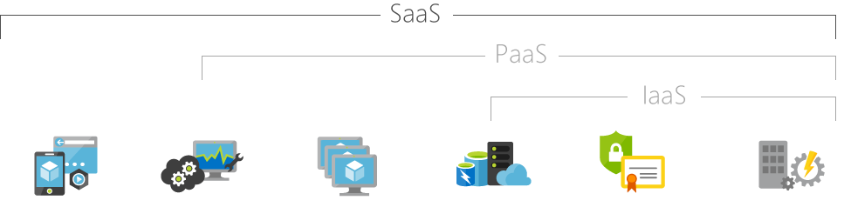
Cloud Computing Models
Hosted applications/apps | Development tools, database management, business analytics | Operating systems | Servers and storage | Networking firewalls/security | Data center physical plant/building
Infrastructure as a Service (IaaS)
Platform as a Service (PaaS)
Software as a Service (SaaS)

Slide 8
Benefits of Cloud Computing
Collaboration and Flexibility
Performance
Cost
Global Scale
Environmentally Friendly
Reliability

Slide 9
Concerns of Cloud Computing
Internet Connectivity
Security
Ongoing Costs
Data Deletion

Slide 10
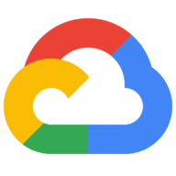
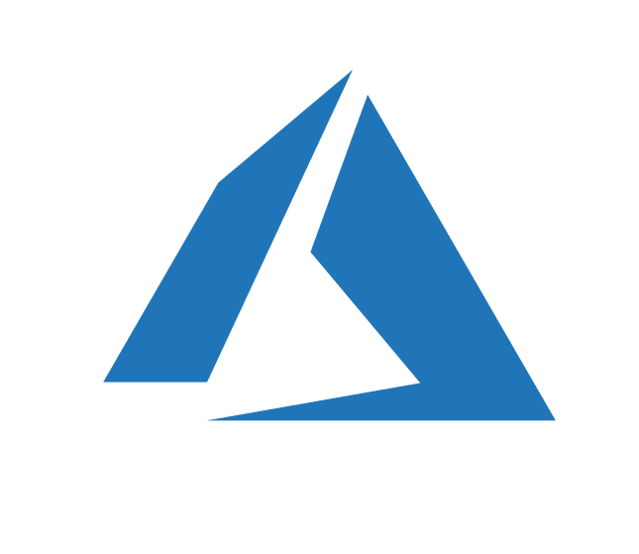
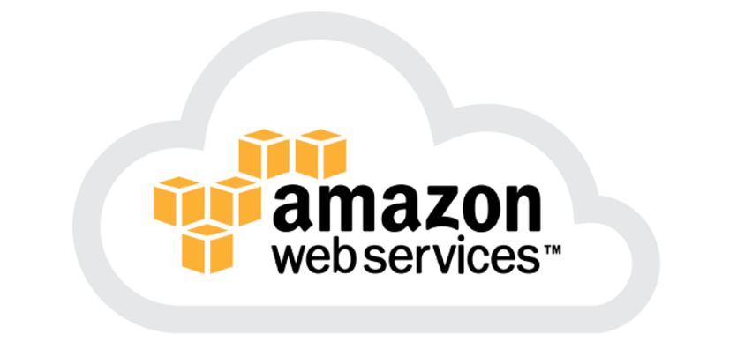
Cloud Computing Services in Industry
Major Providers
Amazon Web Services
Google Cloud
Microsoft Azure
IBM Cloud
Common Services
Ecommerce
Telecommunications
ERP
Customer Relationship
Productivity

Slide 11
Data Centers and Cloud Computing (questions)
What is a data center?
What is the difference between on premise data centers and cloud computing?
How can cloud computing solve the problems of managing software licenses?
What factors should be considered when selecting a cloud vendor or provider? (week 11)
When are private clouds used instead of public clouds?
Explain three issues that need to be addressed when moving to cloud computing or services.

Slide 12
Digital Infrastructure and Performance
System Performance: refers to the ability of a particular system to perform its functions within certain operational parameters, such as:
How quickly a given task is performed
How many data can be stored
How many transactions can be performed in a given timeframe
How many concurrent users can be supported
The ability of the system to safeguard the information
Notes:
capability (power and appropriateness for the task), speed, and cost.

Slide 13
Home Depot Video
How Home Depot navigated a demand boom during COVID-19
Fahim Siddiqui, senior vice president of information technology at Home Depot, to talk e-commerce trends and digital transformation for the retailing giant.
Notes:
https://www.zdnet.com/article/how-home-depot-navigated-a-demand-boom-during-covid-19/

